Slide 1
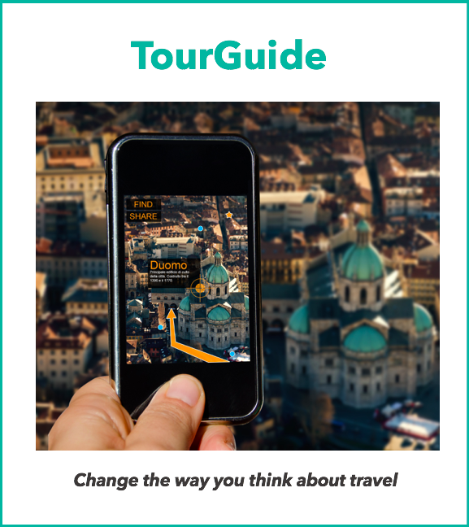
Project 8
Scale Up Your App With Distributed Systems

Slide 2
Summary
Objective of the project
Problem to be solved
Solution
The technical stack of this application
Requirements/Features
SureFire Report
Jacoco Coverage Report

Slide 3
The technical stack of this application
Back-end logic
Java as a development language
Spring Boot Framework
Spring Cloud : openfeign.
Maven
Deployment
Docker

Slide 4
Project Overview
Application allows users to get package deals on hotel stays or find nearby tourist attractions
Project Goals
Improve application performance
Fix multiple bugs
Deploying different Docker containers

Slide 5
Critical tasks
GpsUtil is too slow. Make it faster. It needs to be able to get 100,000 user’s locations within 15 minutes.
RewardsCentral is too slow. Make it faster. It needs to be able to get rewards for 100,000 users within 20 minutes.
Make tripPricer work with the user’s trip preferences. Determine if any pieces of TourGuide can be cut away from the main Spring application, move them into different Dockerized containers, and modify TourGuide to call upon these services as necessary.
Fix users recommended travel destinations bug - add the five attractions closest to the user’s latest location.
Fix the unit tests that intermittently fail. Update existing performance unit tests to prove the speed increases.
Add unit test for the new functionality to get all users’ locations at once.

Slide 6
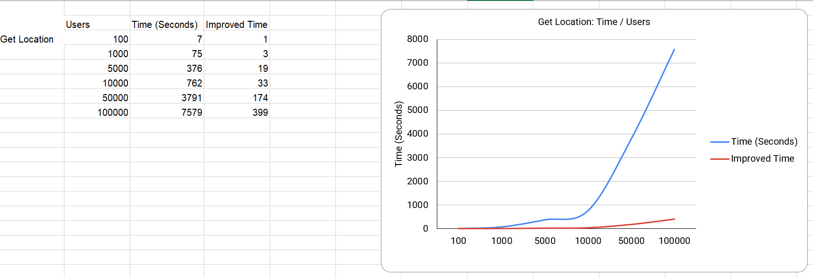
Performance report: High volume track location test

Slide 7
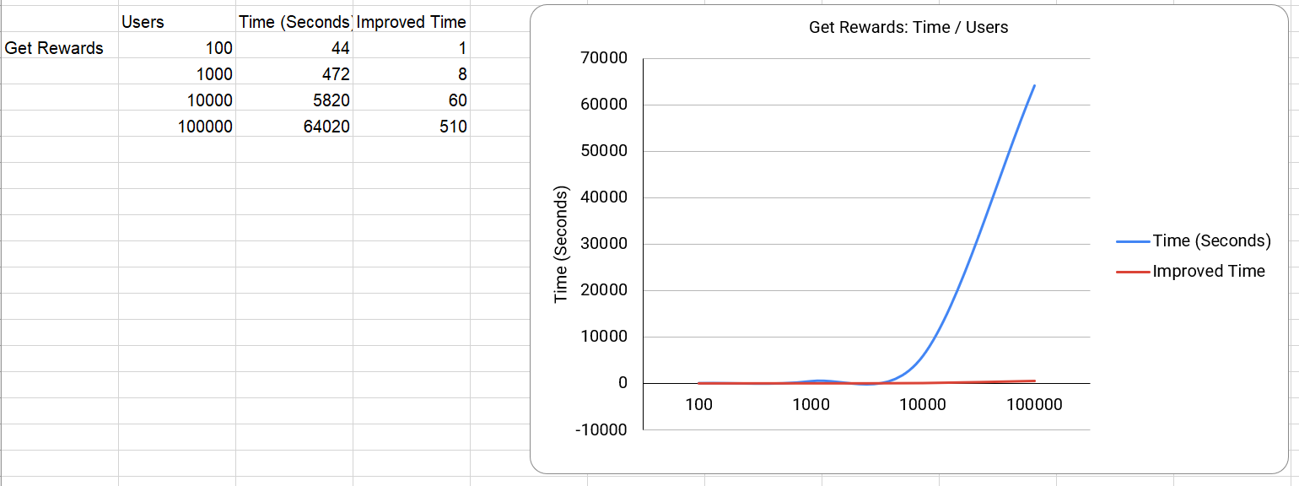
Performance report: High volume get rewards test

Slide 8
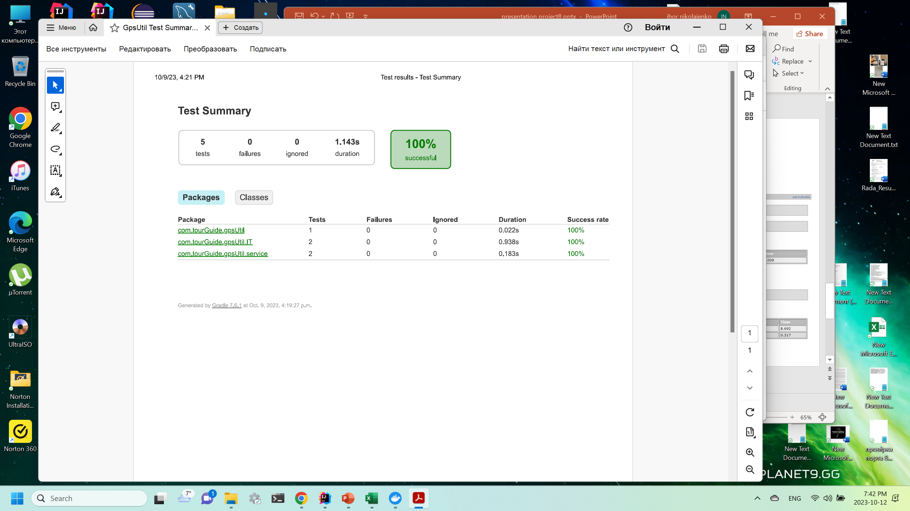
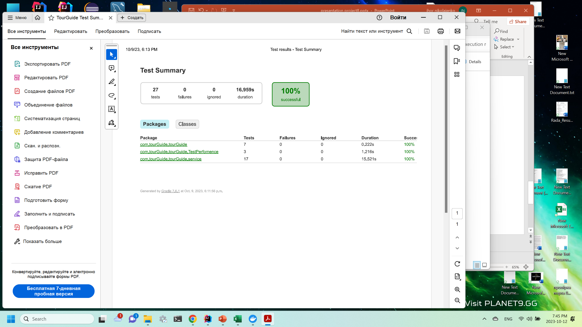
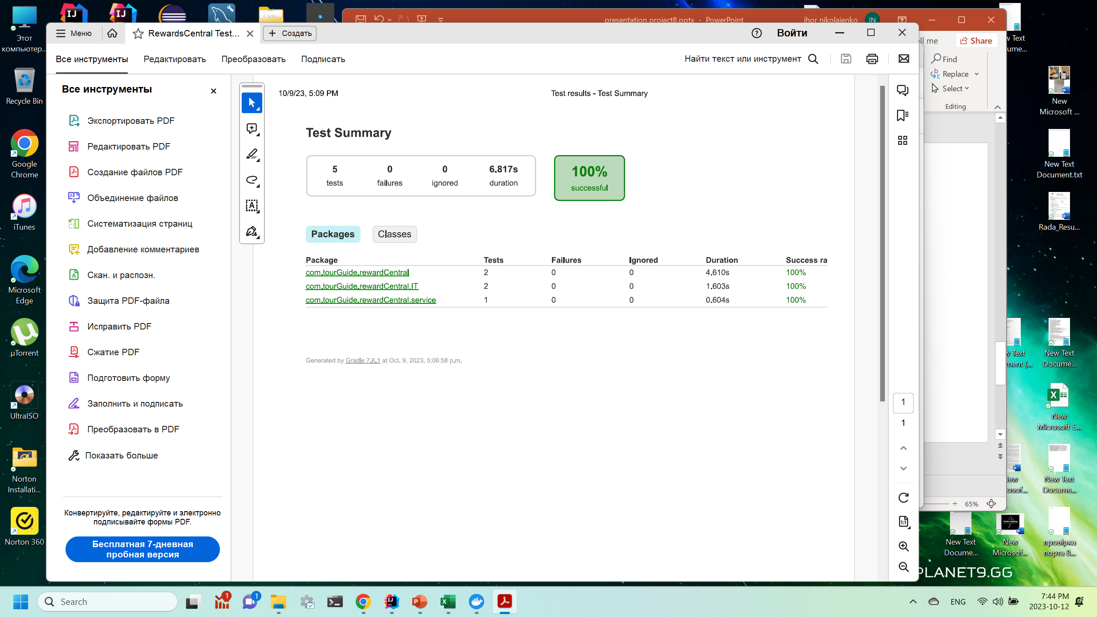

Surefire Report

Slide 9
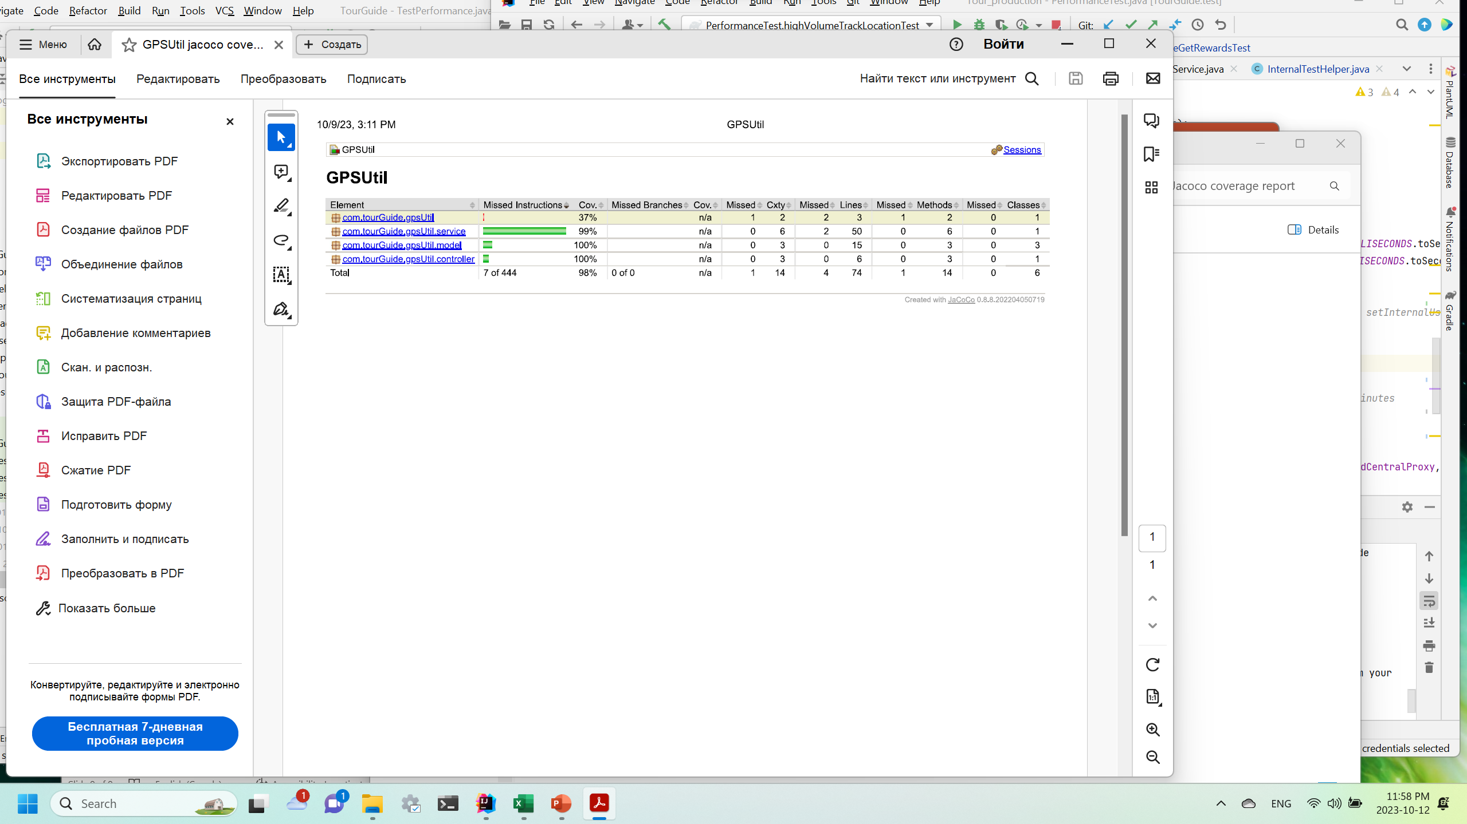
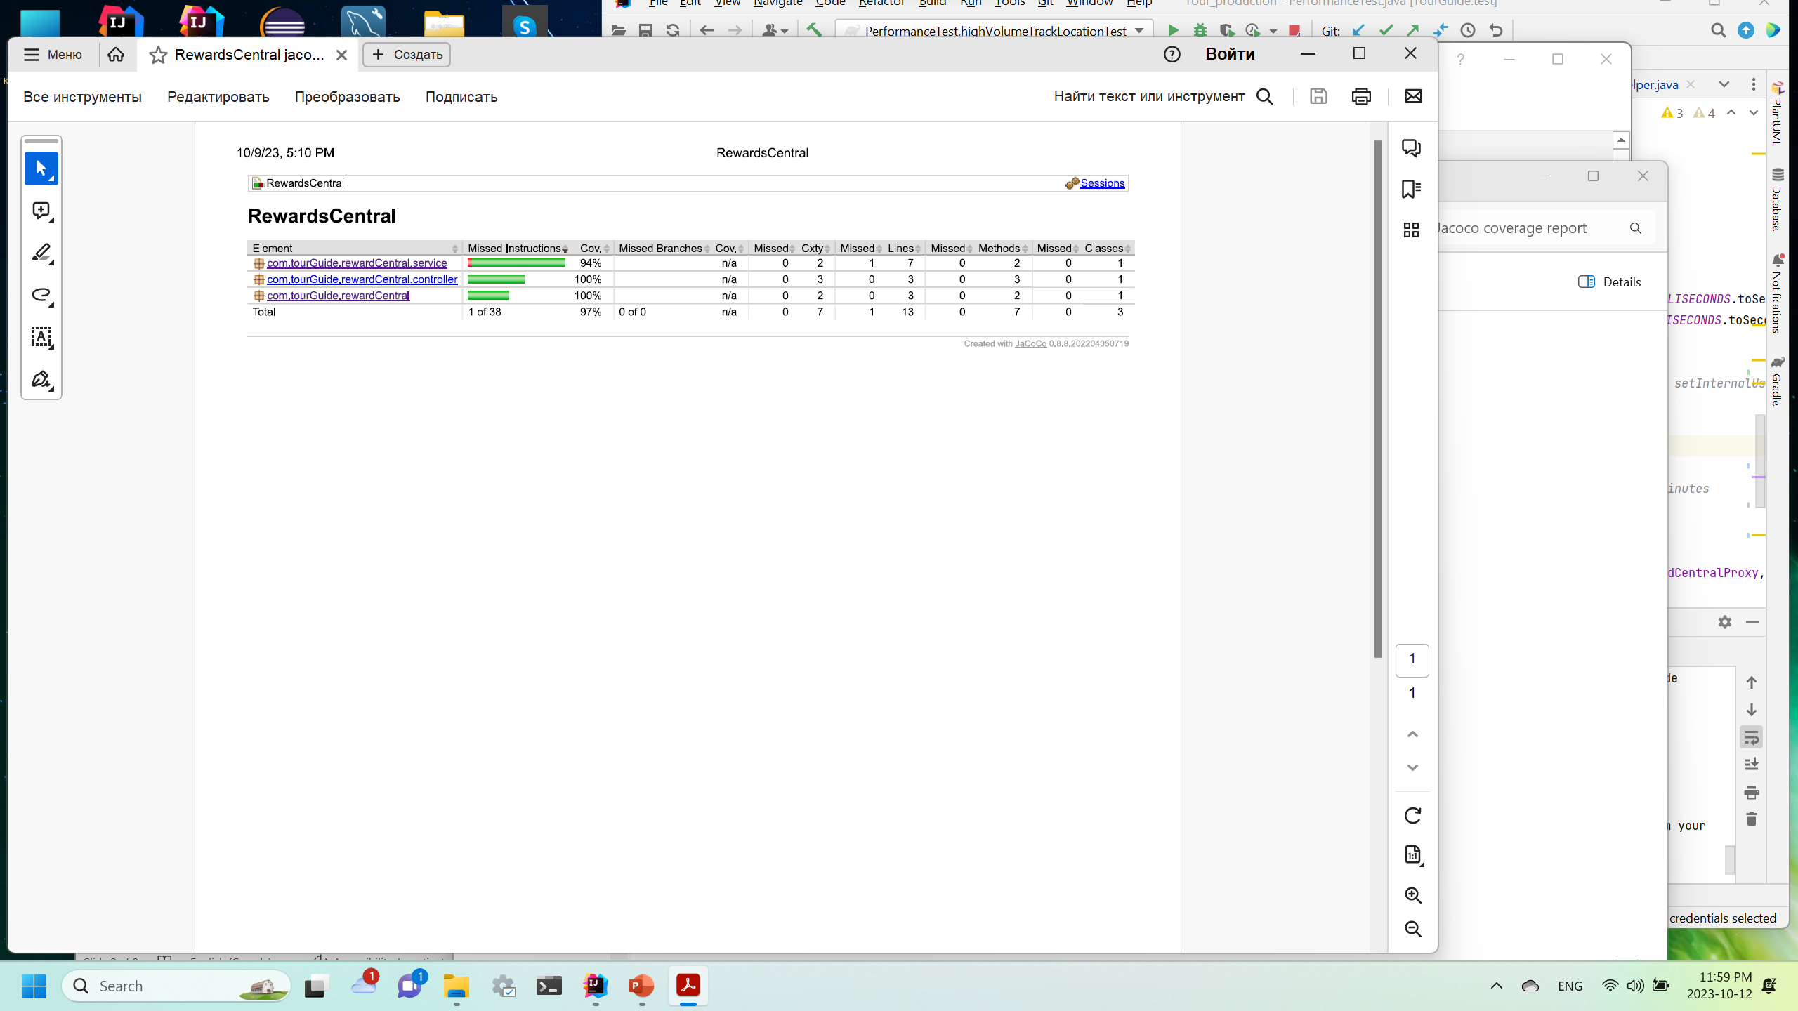
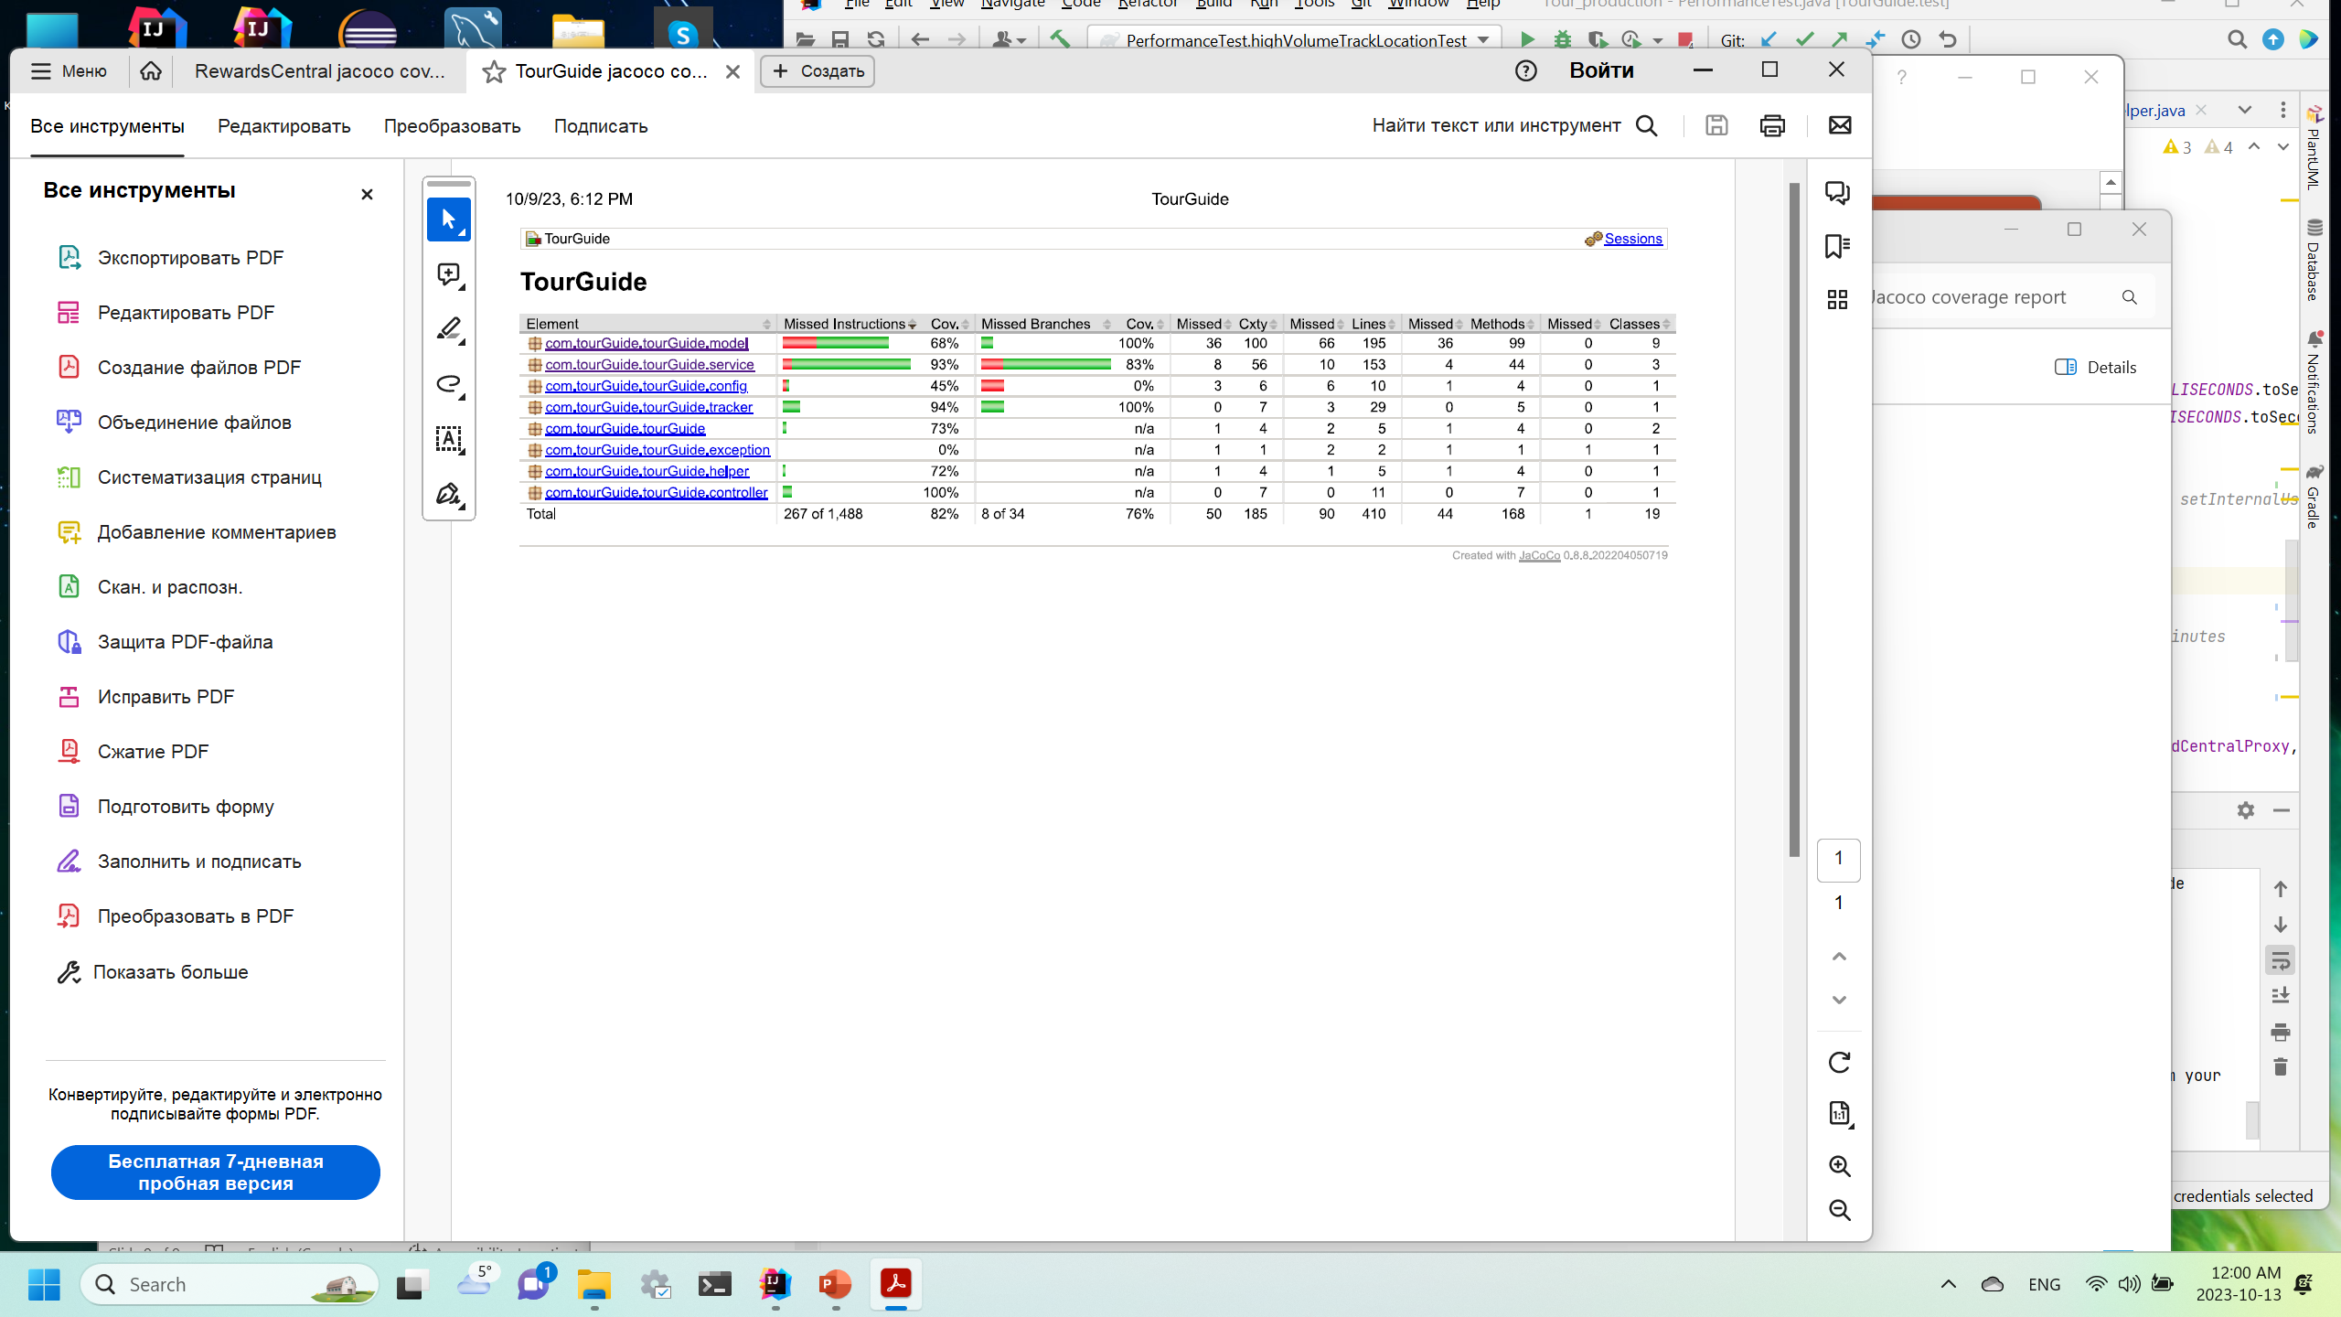
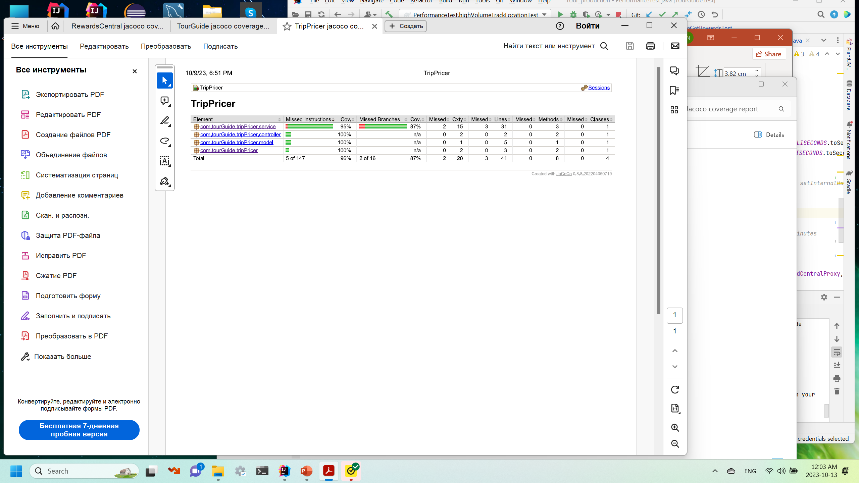
Jacoco Coverage Report

